Slide 1
MOVIES ON STREAMING PLATFORMS
Team Members: AnnMarie Morrison, Mercy Griffin, Taniya Chhabra

Slide 2
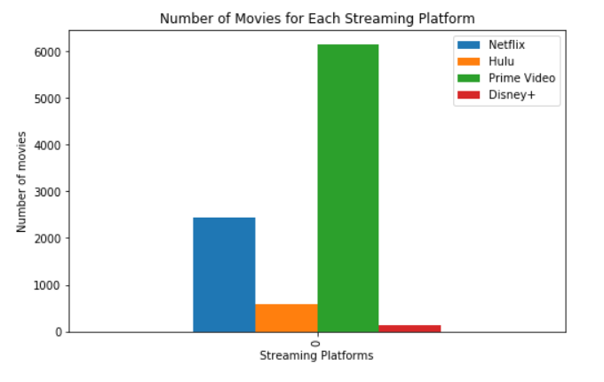
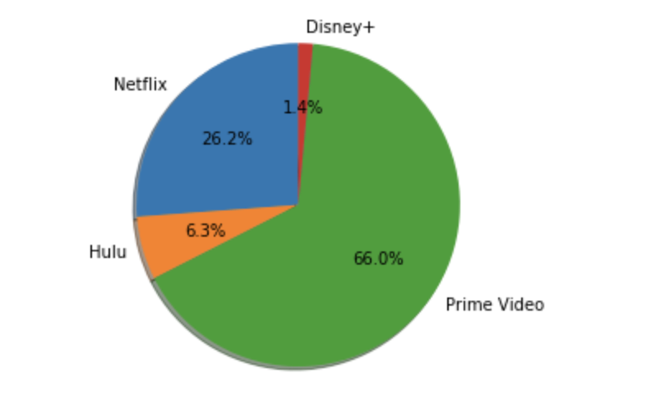
Which streaming platform has the most movies?

